Slide 1
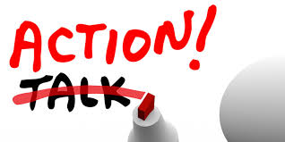
Actions Speak Louder than Words

Slide 2
Titan Creed
Titans love, respect, and protect one another.

Slide 3
Are you truly a friend?
The definition of a friend is “a person who gives assistance; patron; supporter; a person who is on good terms with another; a person who is not hostile.”
How well do you fit that definition?

Slide 4
Story – Making a Difference
The group of boys in the story was malicious (deliberately harmful/spiteful).
Many of you would never dream of being physically malicious, but do you realize that MANY of you are being verbally malicious –to your friends.
Is it OK to call your friend or another person names based on physical characteristics? Even if you are joking?
How does it make a person feel to be called a name over and over and over – in joking – by your friends?
Calling your friends names is an oxymoron (contradiction in terms). Why would this be consider an oxymoron?
Notes:
The story that goes with this slide is printed in your mailbox, or you can find a copy in your email.

Slide 5
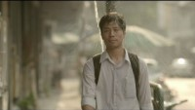
Doing the Right Thing
Notes:
https://www.youtube.com/watch?v=uaWA2GbcnJU&t=3s
- This is a commercial so there is a pop up for the company at the end that you can skip.

Slide 6
Discussion Questions
Do words have power? Why or why not?
Do actions have power? Why or why not?
What does “Actions speak louder than words” mean?
Saying what they think could be harmful to someone. Is it always appropriate to be completely forward with our thoughts, feelings, and opinions?
Can you speak honestly but also speak tactfully (the ability to speak/act without offending)?

Slide 7
“In the end, the extent of your influence depends on the depth of your concern for others.”
John Maxwell
“Act as if what you do makes a difference. It does.”
William James
“People will forget what you said, people will forget what you did, but people will never forget how you made them feel.”
Maya Angelou

Slide 8
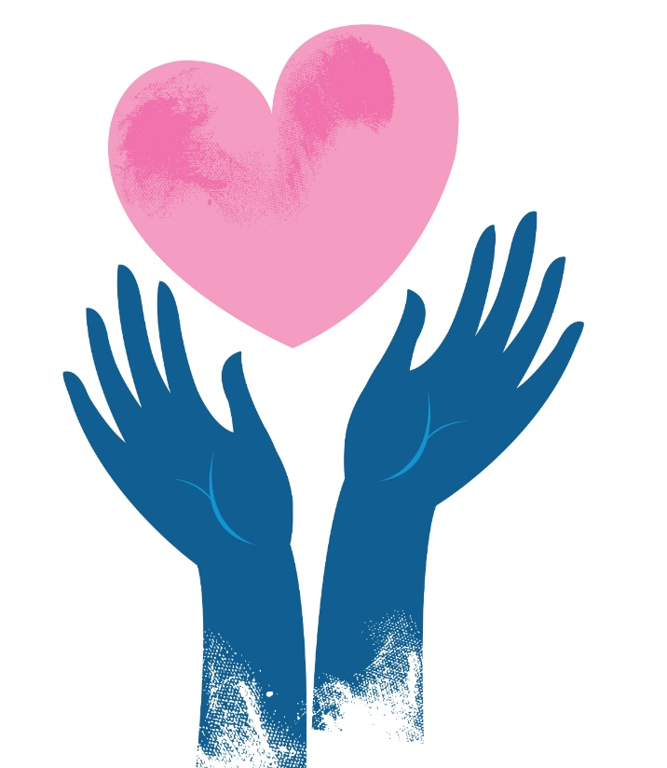
Are YOU treating others as you would like to be treated?

